Slide 1
Transform and Conquer II

Slide 2
Announcements
Reminder: Homework 3 assigned
Covers Decrease & Conquer and Divide & Conquer

Slide 3
Transform and Conquer
First: Transform problem instance to form that is more amenable to solution.
Instance Simplification: simpler instance of same problem.
Representation Change: different representation of same instance.
Problem Reduction: instance of different problem for which algorithm is already available.
Second: Solve it!

Slide 4
Heaps
Representation Change

Slide 5
Heap
Partially Sorted Data Structure
Ideal for Priority Queues
Good for process scheduling, network traffic management, various algorithms (Prim’s, Dijkstra’s, Huffman, A*, etc.)
Cornerstone of heapsort

Slide 6
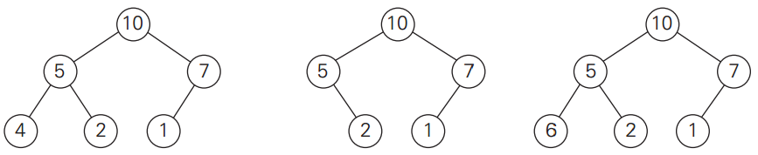
Heap
Heap: a binary tree that has 2 properties:
Shape property: tree is complete – all levels are full except for last, which is filled from left to right.
Heap property: the key in each node is greater* than or equal to key in each of its children.
Order of children irrelevant

Slide 7
Heap Properties
Only one complete tree with n nodes. Height is always log₂n.
Root always largest* key value.
Each subpart of tree is a heap.
9
8
7
5
2
1
6
3
5
1

Slide 8
Array Representation
 | 9 | 8 | 7 | 5 | 2 | 1 | 6 | 3 | 5 | 1
0 | 1 | 2 | 3 | 4 | 5 | 6 | 7 | 8 | 9 | 10
Most languages provide function to heapify an array/list.
heapq in Python
9
8
7
5
2
1
6
3
5
1

Slide 9
Array Representation
 | 9 | 8 | 7 | 5 | 2 | 1 | 6 | 3 | 5 | 1
0 | 1 | 2 | 3 | 4 | 5 | 6 | 7 | 8 | 9 | 10
Where is parent of node i?
9
8
7
5
2
1
6
3
5
1

Slide 10

Array Representation
 | 9 | 8 | 7 | 5 | 2 | 1 | 6 | 3 | 5 | 1
0 | 1 | 2 | 3 | 4 | 5 | 6 | 7 | 8 | 9 | 10
Where is parent of node i? $\left\lfloor i/2\right\rfloor$
9
8
7
5
2
1
6
3
5
1

Slide 11
Array Representation
 | 9 | 8 | 7 | 5 | 2 | 1 | 6 | 3 | 5 | 1
0 | 1 | 2 | 3 | 4 | 5 | 6 | 7 | 8 | 9 | 10
Where is left child of node i?
9
8
7
5
2
1
6
3
5
1

Slide 12
Array Representation
 | 9 | 8 | 7 | 5 | 2 | 1 | 6 | 3 | 5 | 1
0 | 1 | 2 | 3 | 4 | 5 | 6 | 7 | 8 | 9 | 10
Where is left child of node i? 2i
9
8
7
5
2
1
6
3
5
1

Slide 13
Array Representation
 | 9 | 8 | 7 | 5 | 2 | 1 | 6 | 3 | 5 | 1
0 | 1 | 2 | 3 | 4 | 5 | 6 | 7 | 8 | 9 | 10
Where is right child of node i?
9
8
7
5
2
1
6
3
5
1

Slide 14
Array Representation
 | 9 | 8 | 7 | 5 | 2 | 1 | 6 | 3 | 5 | 1
0 | 1 | 2 | 3 | 4 | 5 | 6 | 7 | 8 | 9 | 10
Where is right child of node i? 2i + 1
9
8
7
5
2
1
6
3
5
1

Slide 15
Constructing a Heap: Θ(n)
HeapBottomUp(H[1…n])
for i ← floor(n/2) downto 1 do
k ← i
v ← H[k]
heap ← false
while not heap and 2*k ≤ n do
j ← 2 * k
if j < n // there are 2 children
if H[j] < H[j+1]
j ← j + 1
if v ≥ H[j]
heap ← true
else
H[k] ← H[j]
j ← k
H[k] ← v
Convert to array representation and run HeapBottomUp
2
9
7
6
5
8

Slide 16
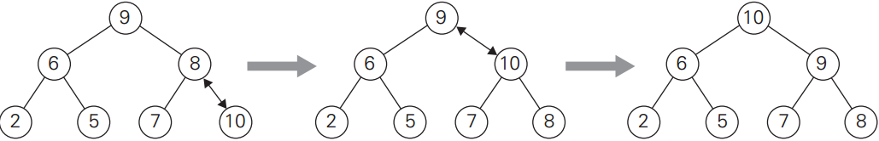
Heap Push: Θ(log₂n)
HeapPush(H[1…n], k)
H[n+1] ← k
i ← n+1
heap ← false
while not heap and i ≠ 1 do
p ← floor(i/2)
if H[i] > H[p]
swap H[i] and H[p]
i ← p
else
heap ← true

Slide 17
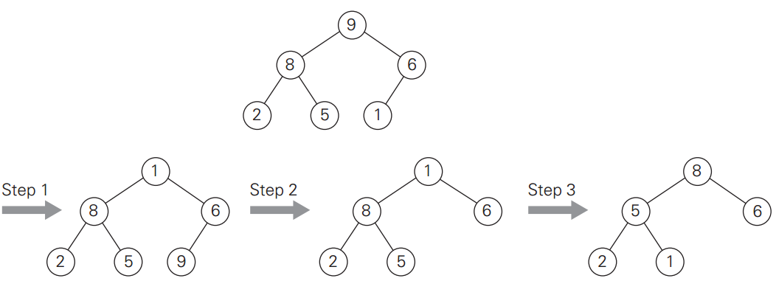
Heap Pop: Θ(log₂n)
Pops root – largest item
Often returns item in addition to removing

Slide 18
Your Turn …
Imagine that you start with an empty max-heap. Draw the heap (in tree format) after each of the following operations. heap_push(10) heap_push(5) heap_push(11) heap_push(6) heap_push(2) heap_pop()

Slide 19
Heapsort
Construct heap from array
Call heap pop repeatedly until empty (could add popped items into new array if desired)
What would Big-Θ of Heapsort be?

Slide 20
Heapsort
Construct heap from array
Call heap pop repeatedly until empty (could add popped items into new array if desired)
What would Big-Θ of Heapsort be? T(n) = T(construct) + n * T(pop) = Θ(n) + n * Θ(log₂n) = Θ(n log₂n)
Comparable to mergesort

Slide 21
Balanced Search Trees

Slide 22
BST
Converting list to BST is a transformation change, what do we gain?
Best/Avg. Case?
Worst Case?

Slide 23
BST
9
Converting list to BST is a transformation change, what do we gain?
Best/Avg. Case: Θ(log n) insert, search, etc.
Worst Case: nothing, still Θ(n)
8
6
6
5
6
2
8
2
1
5
6
9
1

Slide 24
How to Avoid BST Worst Case?
Instance Simplification: if an insertion breaks balance rule, use rotation to restructure tree.
AVL Tree
Others: Red-Black Tree, Splay Tree
Representation Change: allow more than one item in each node:
2-3 Trees
Others: B-Trees

Slide 25
AVL Trees
AVL Tree: a BST in which the balance factor of every node is either 0, +1 or -1.
Balance Factor: the difference between heights of the nodes left and right subtrees. What is balance factor of nodes in this BST? Is it an AVL tree?
7
3
9
2
5
1
6
Notes:
Named for Adelson-Velsky and Landis.

Slide 26
AVL Trees
AVL Tree: a BST in which the balance factor of every node is either 0, +1 or -1.
Balance Factor: the difference between heights of the nodes left and right subtrees. Is it an AVL tree? No.
7
2
3
0
9
0
1
2
5
-1
0
1
6
0
Notes:
Named for Adelson-Velsky and Landis.

Slide 27
AVL Trees
AVL Tree: a BST in which the balance factor of every node is either 0, +1 or -1.
Balance Factor: the difference between heights of the nodes left and right subtrees. This IS an AVL tree.
7
1
3
0
9
1
1
2
5
-1
0
8
0
1
6
0
Notes:
Named for Adelson-Velsky and Landis.

Slide 28
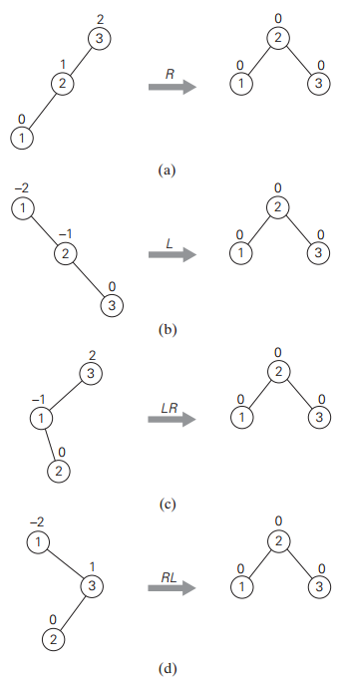
Rotations
If insertion leads a node to have +2 or -2, perform one of 4 possible rotations to rebalance.
If more than one such node, rotate one closest to inserted leaf.

Slide 29
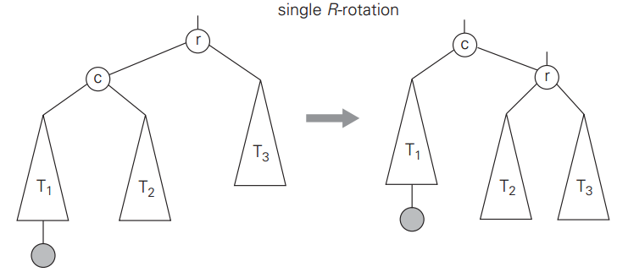
R-rotation
Performed after new key inserted into left subtree of left child causing +2 balance factor.
r: node with +2 balance factor c: left child of r
L-rotation is mirror image (-2 balance factor)
Is BST order preserved?

Slide 30
R-rotation
Create pointers to r, c and parent of r
Move r’s lchild pointer from c to T2
Move c’s rchild pointer from T2 to r
Move parent of r’s child pointer from r to c.
Θ?

Slide 31
R-rotation
Create pointers to r, c and parent of r
Move r’s lchild pointer from c to T2
Move c’s rchild pointer from T2 to r
Move parent of r’s child pointer from r to c.
Θ(1)

Slide 32
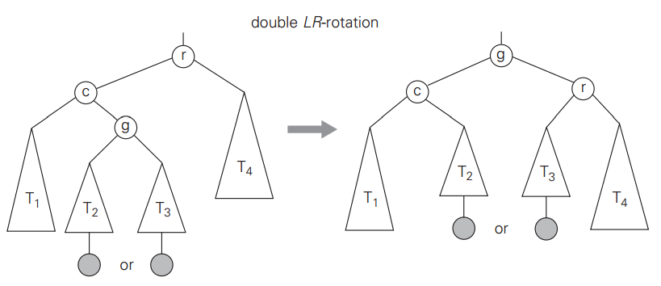
LR-rotation
An L-rotation followed by an R-rotation. Performed after key inserted into right subtree of left child causing +2 balance factor.
RL-rotation is mirror image.

Slide 33
AVL Trees
Leads to search, insert, remove all being Θ(log₂n) in best, worst and average case.
Not widely used, due to frequent rotations.
Generated idea of rebalancing, which is used in other tree implementations.

